Slide 1
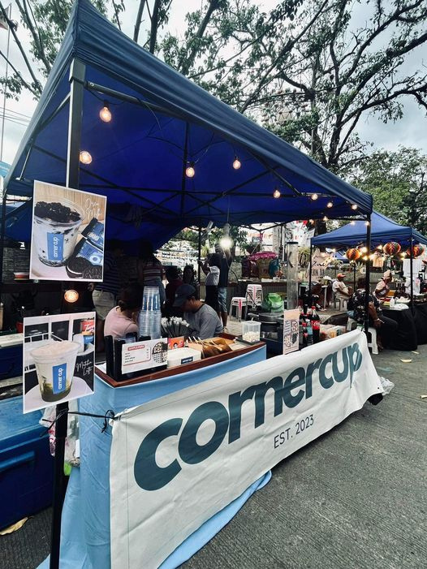

POINT OF SALES
cornercup
EST. 2023

Slide 2





Content
01
Our Team
02
Overview
03
Language
04
Features
05
User Case Diagram
06
Entity Relationship Diagram
07
Database of CORNERCUP POS
08
Documentations

Slide 3







CORNERCUP POINT OF SALES (POS) TEAM
BEDOL, ZAIRA MAE
CELICIOUS, CHRISTINE BERNA
EBCAY,
CRISTINE JOY
OLIVEROS, DEBORAH
PAYUSAN, JURIZZA
SALERA,
KEEN HART
Marketing Head
Marketing Head

Slide 4
Content
01
Our Team
02
Overview
03
Language
04
Features
05
User Case Diagram
06
Entity Relationship Diagram
07
Database of CORNERCUP POS
08
Documentations

Slide 5
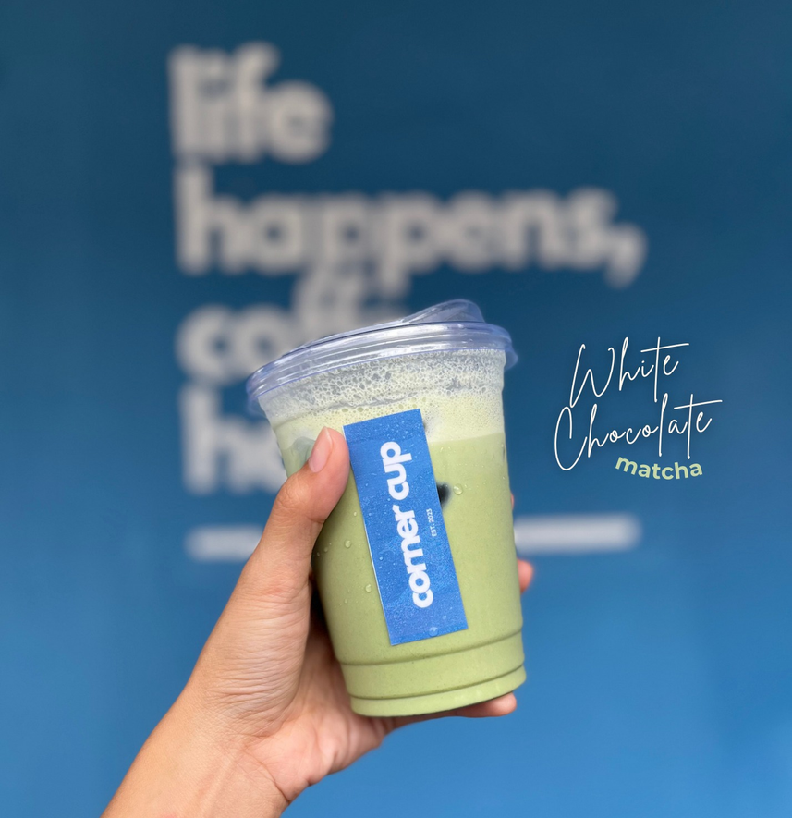
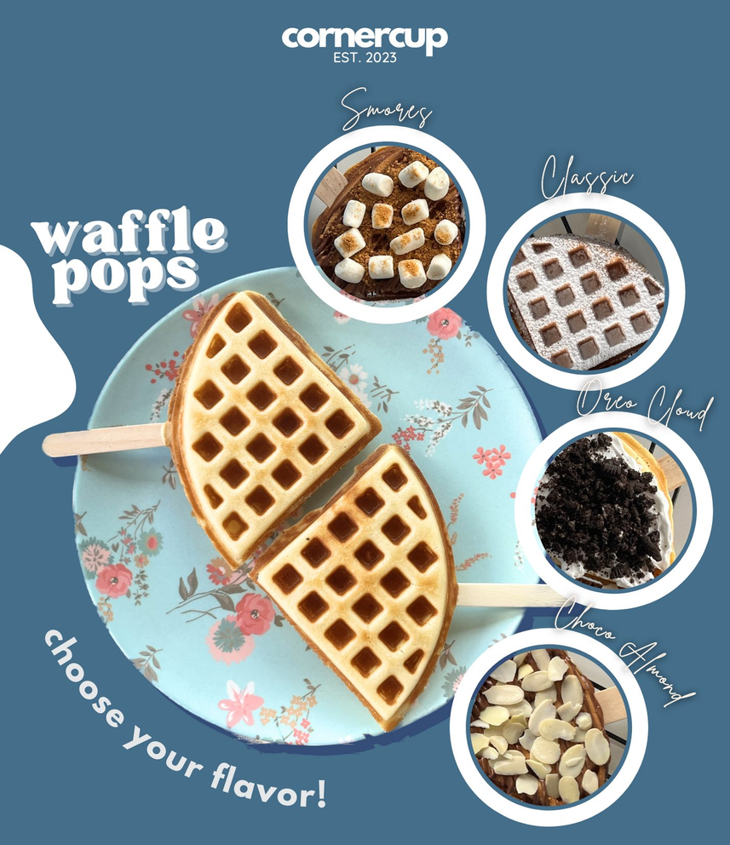
OVERVIEW
CORNERCUP Point of Sales (POS) System in PHP MySQL is an application for managing products, sales, and billing. This application has many features like adding categories, products, cashiers, admins, etc. You can also create orders and manage the billing process. You can also view the analytics for all data.

Slide 6
Content
01
Our Team
02
Overview
03
Language
04
Features
05
User Case Diagram
06
Entity Relationship Diagram
07
Database of CORNERCUP POS
08
Documentations

Slide 7
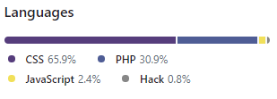




LANGUAGES

Slide 8
Content
01
Our Team
02
Overview
03
Language
04
Features
05
User Case Diagram
06
Entity Relationship Diagram
07
Database of CORNERCUP POS
08
Documentations

Slide 9








FEATURES OF CORNERCUP POINT OF SALES (pos)
CATEGORIES MANAGEMENT
(ADD, EDIT, UPDATE, DELETE)
PRODUCTS MANAGEMENT (ADD,EDIT, UPDATE, DELETE)
LOGIN SYSTEM USING SESSION

Slide 10



FEATURES OF CORNERCUP POINT OF SALES (pos)
ORDER CREATION:
CASHIERS MANAGEMENT
(ADD, EDIT, UPDATE, DELETE)
ADMINS MANAGEMENT
(ADD, EDIT, UPDATE, DELETE)
Product Selection
Quantity Addition and Session Cart
HTML Table Listing
Quantity Manipulation
Product Removal

Slide 11




FEATURES OF CORNERCUP POINT OF SALES (pos)
ORDER SUMMARY
ORDER
ORDER PLACEMENT
Customer Details Review
Invoice Details
Product Review
Modification Option
Order Saving
Printing Orders
Order Download in PDF
Cashier’s Order List
Filtering Options
Order Details View
Printing and PDF Download
Payment Mode Selection
Enter Cashier Name

Slide 12


FEATURES OF CORNERCUP POINT OF SALES (pos)
DASHBOARD ANALYTICS

Slide 13
Content
01
Our Team
02
Overview
03
Language
04
Features
05
User Case Diagram
06
Entity Relationship Diagram
07
Database of CORNERCUP POS
08
Documentations

Slide 14


USER CASE DIAGRAM FOR CORNERCUP
POINT OF SALE (POS) SYSTEM
USER AUTHENTICA-TION
PRODUCT MANAGEMENT
CATEGORIES
MANAGEMENT
CREATE ORDERS
/BILLING
MANAGER
DASHBOARD ANALYTICS
ORDERS
(TRANSACTION HISTORY)
CASHIER
ADMIN & CASHIER MANAGEMENT

Slide 15
Content
01
Our Team
02
Overview
03
Language
04
Features
05
User Case Diagram
06
Entity Relationship Diagram
07
Database of CORNERCUP POS
08
Documentations

Slide 16


E.R. DIAGRAM FOR CORNERCUP POINT OF SALE (POS) SYSTEM
admins
PK
id
name
emaIl
password
phone
is_ban
created_at
categories
orders
PK
products
id
name
description
status
PK
id
cashier_id
tracking_no
invoice_no
total_amount
order_date
order_status
payment_mode
order_placed_by_id
PK
id
category_id
name
description
price
quantity
image
status
created_at
FK
FK
order_items
cashiers
PK
PK
id
order_id
product_id
price
quantity
id
cname
emaIl
phone
status
created_at
FK
FK

Slide 17
Content
01
Our Team
02
Overview
03
Language
04
Features
05
User Case Diagram
06
Entity Relationship Diagram
07
Database of CORNERCUP POS
08
Documentations

Slide 18

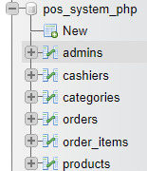
DATABASE OF CORNERCUP POINT OF SALE (POS) SYSTEM
Our PHP-based Simple POS System utilizes a MySQL database with a well-organized structure. We've created a database named "pos_system_php" consisting of six key tables, each serving a distinct purpose in the seamless functioning of the system:
admins
cashiers
categories
orders
order_items
products

Slide 19
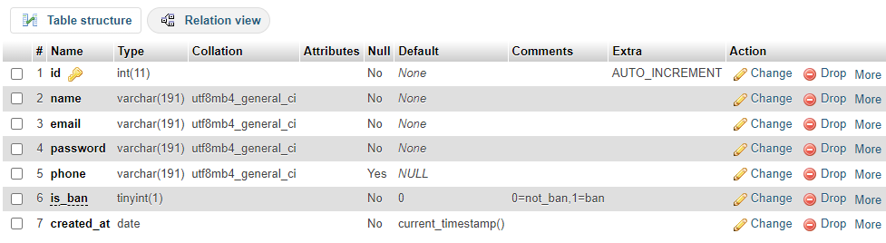
DATABASE OF CORNERCUP POINT OF SALE (POS) SYSTEM
admins

Slide 20
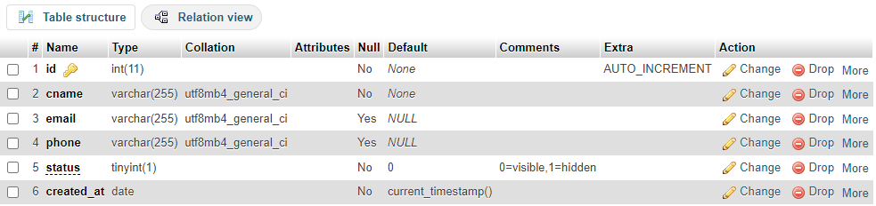
DATABASE OF CORNERCUP POINT OF SALE (POS) SYSTEM
cashiers

Slide 21
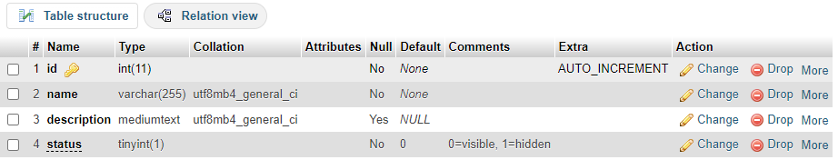
DATABASE OF CORNERCUP POINT OF SALE (POS) SYSTEM
categories

Slide 22
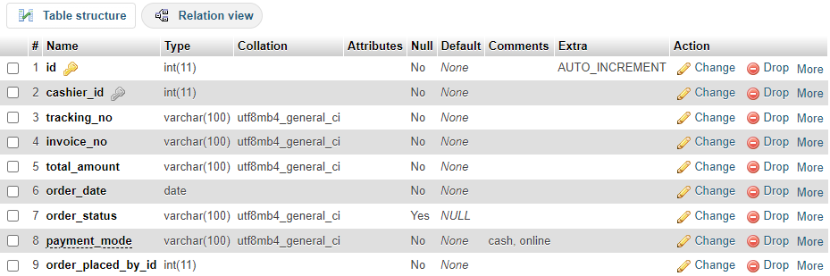
DATABASE OF CORNERCUP POINT OF SALE (POS) SYSTEM
order

Slide 23
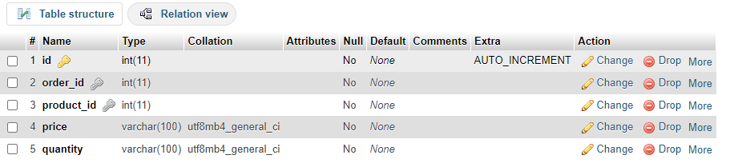
DATABASE OF CORNERCUP POINT OF SALE (POS) SYSTEM
order_items

Slide 24
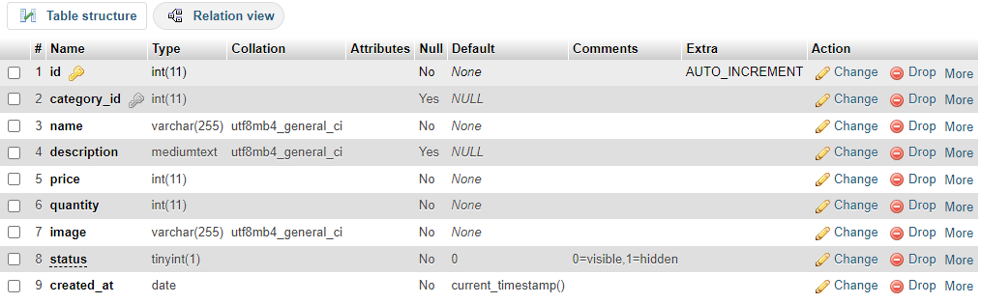
DATABASE OF CORNERCUP POINT OF SALE (POS) SYSTEM
products

Slide 25
Content
01
Our Team
02
Overview
03
Language
04
Features
05
User Case Diagram
06
Entity Relationship Diagram
07
Database of CORNERCUP POS
08
Documentations

Slide 26
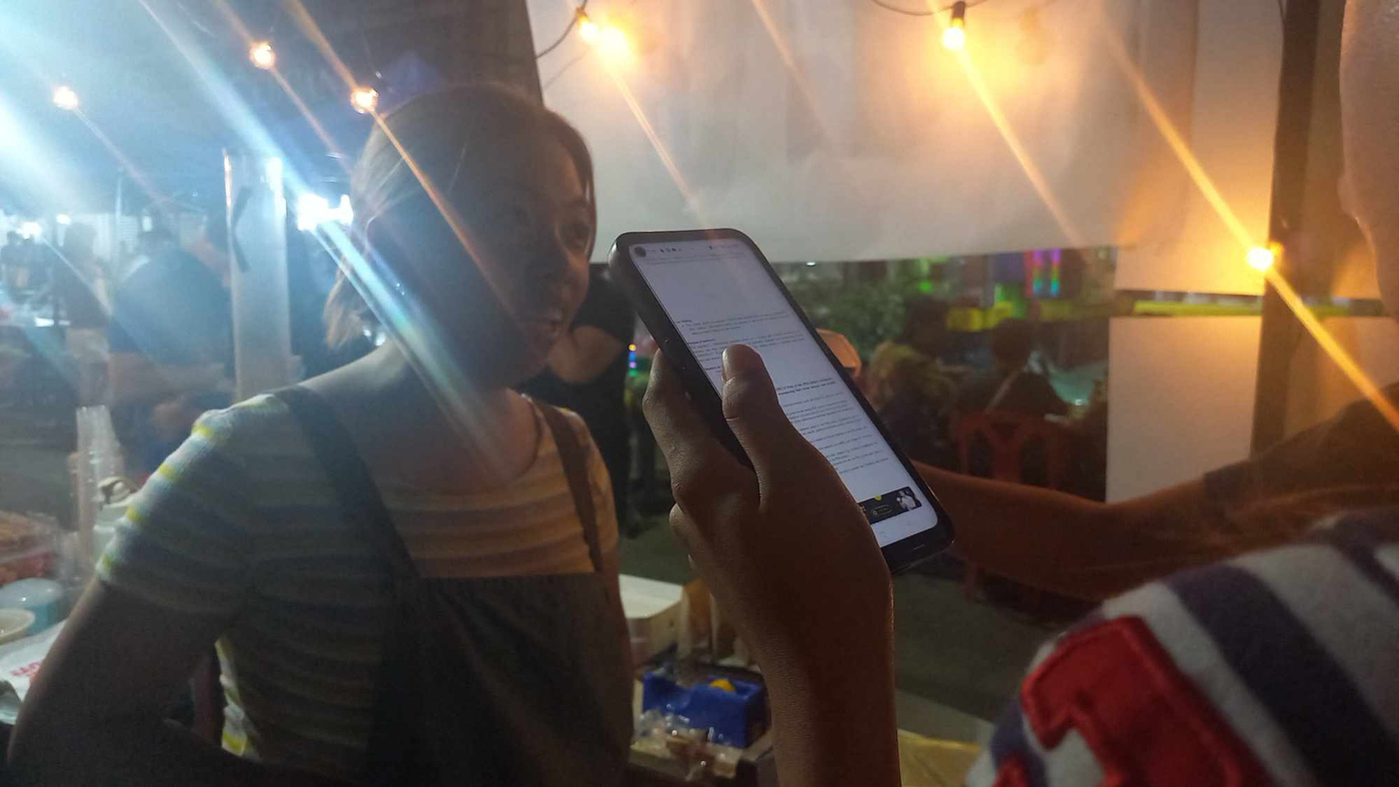
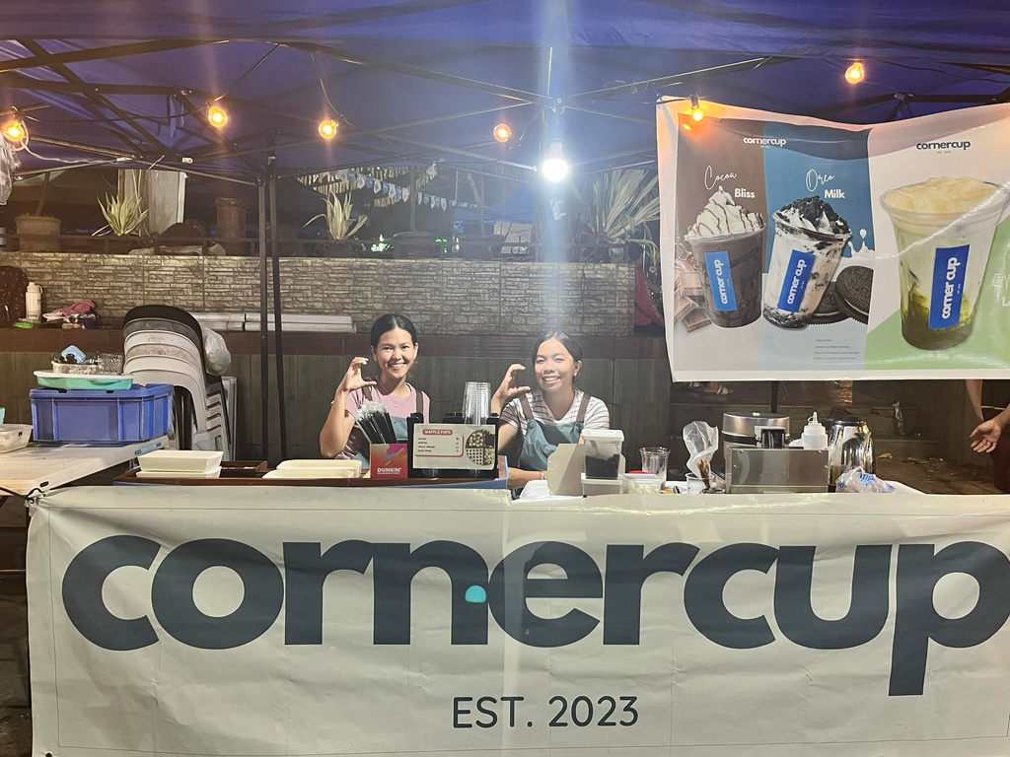
DOCUMENTATION
The Night of Interview with the Client

Slide 27
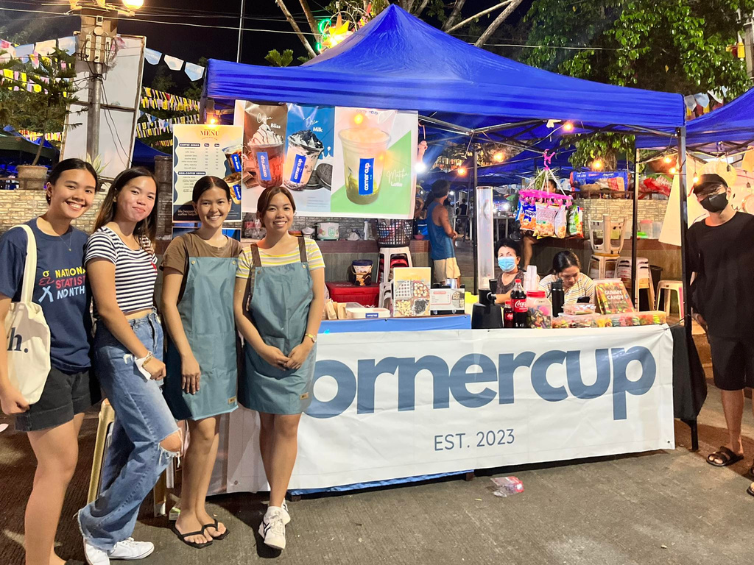
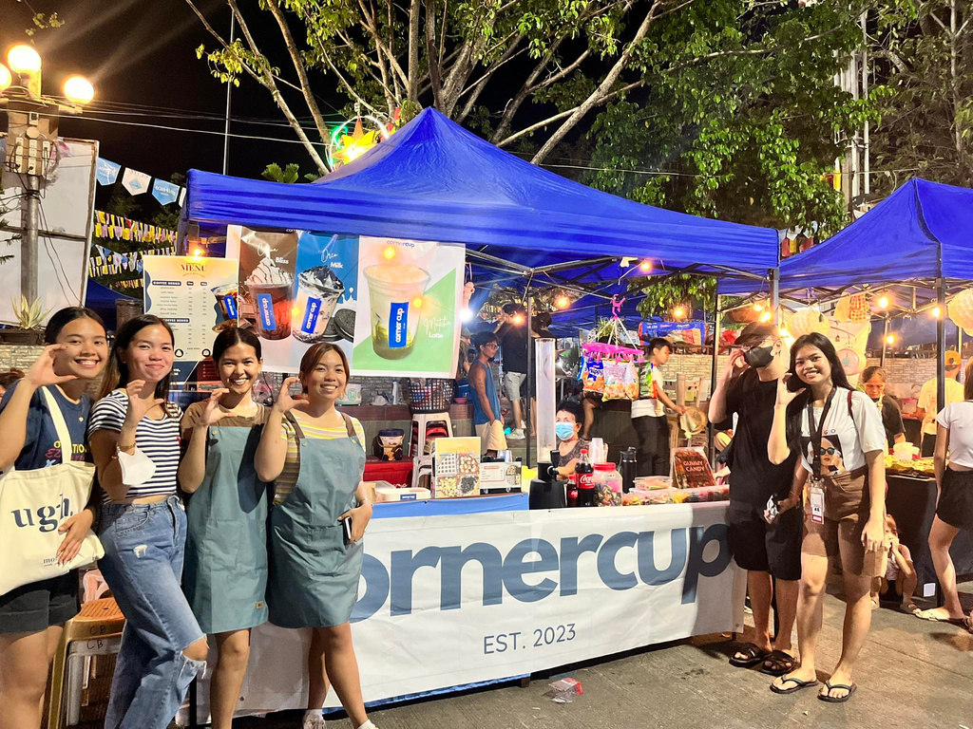
DOCUMENTATION
The Night of Interview with the Client

Slide 28
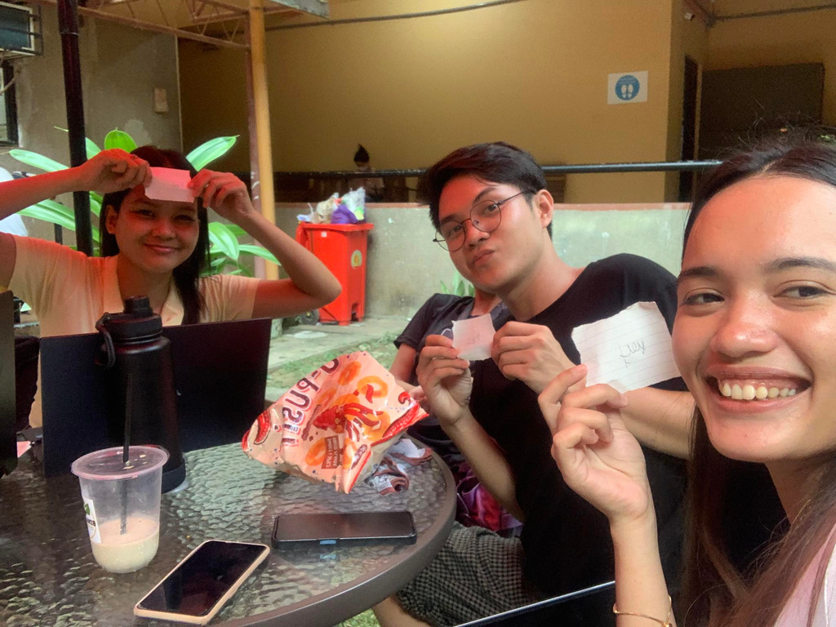

DOCUMENTATION
Learning the process.

Slide 29
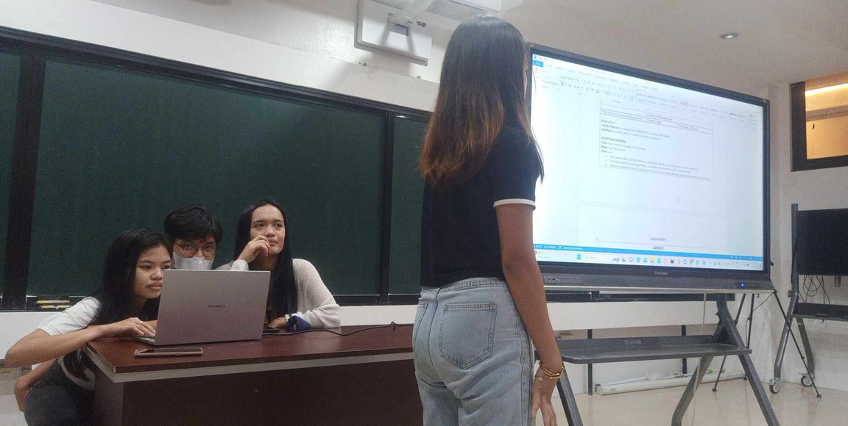


DOCUMENTATION
Introducing the app.

Slide 30
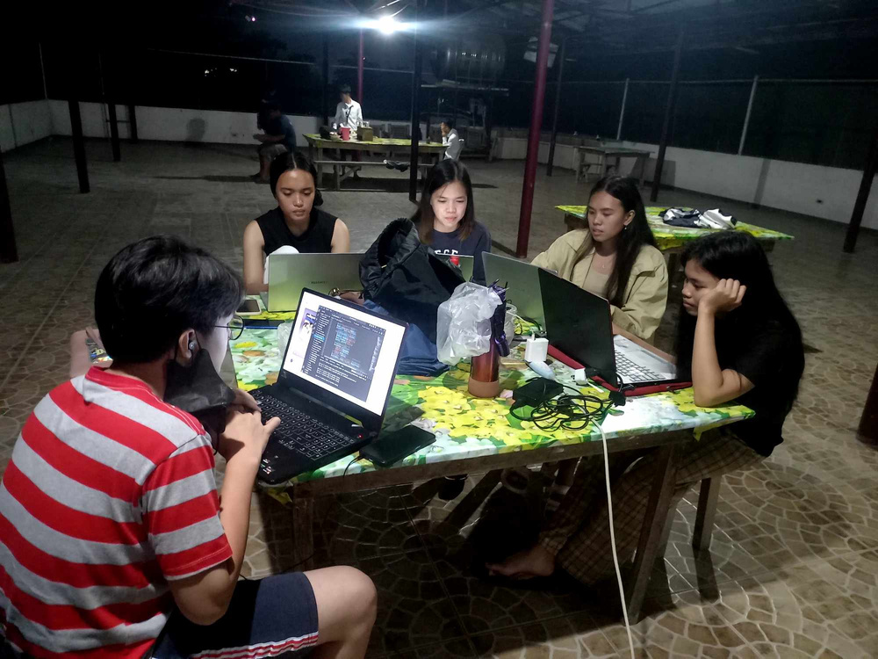
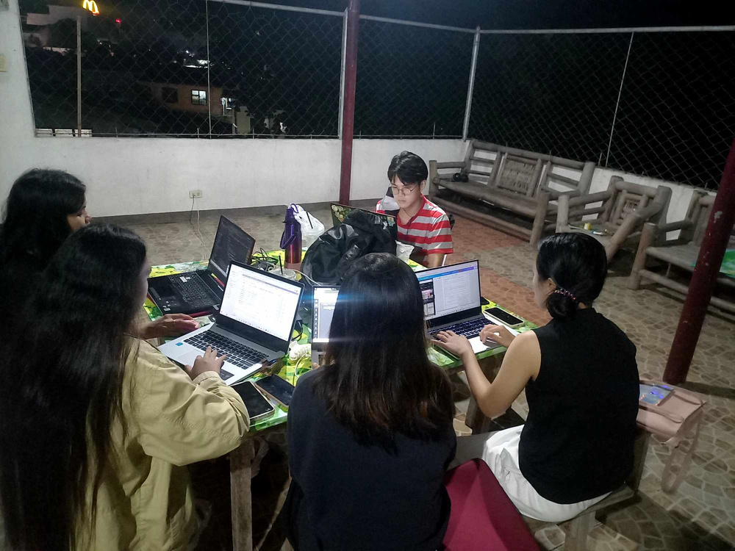
DOCUMENTATION
Building/ on the process of making the app.

Slide 31
SEE THE FINAL RESULT OF THE CORNERCUP POINT OF SALES (POS)
WEB-APP

